Slide 1
Day 7 – Microservices Training
Nikhil Damle
Amar Durga Tatyasaheb Patil
November – December 2021

Slide 2
Microservices Advanced Topics
Native Query vs Entity Graph
Microservices Deployment
Inter Service Communication
Internationalization (i18N)
Circuit Breaker
Transaction Management

Slide 3
Defining a Native Query
When using plain JPA or Hibernate, defining and executing a native query requires multiple steps. Spring Data’s @Query annotation removes all the boilerplate code.
When defining a native query, you annotate your repository method with @Query, set its nativeQuery attribute to true, and provide an SQL statement as the value. As shown in the following code snippet, you can use bind parameters in the same way as in a custom JPQL query.
After you’ve done that, you only need to inject your repository into one of your services and call the getAuthorsByFirstName method with the firstName for which you want to search
Spring Data’s repository implementation then provides the required code to instantiate a query for the statement provided in your @Query annotation. It then sets the provided value as a bind parameter on that query and executes it.
@Repository
public interface AuthorRepository extends CrudRepository<Author, Long>, PagingAndSortingRepository<Author, Long> {
@Query(value="select * from author a where a.first_name= :firstName", nativeQuery=true)
List<Author> getAuthorsByFirstName(String firstName);
}
List<Author> authors = authorRepository.getAuthorsByFirstName(“Test");

Slide 4
The Entity Graphs
In Spring Data JPA, we can define an entity graph using a combination of @NamedEntityGraph and @EntityGraph annotations. Or, we can also define ad-hoc entity graphs with just the attributePaths argument of the @EntityGraph annotation.
First, we can use JPA's @NamedEntityGraph annotation directly on our Item entity:
@Entity
@NamedEntityGraph(name = "Item.characteristics", attributeNodes = @NamedAttributeNode("characteristics") )
public class Item {
@Id private Long id;
private String name;
@OneToMany(mappedBy = "item") private List<Characteristic> characteristics = new ArrayList<>(); // getters and setters
//...
}

Slide 5
@Entity
public class Characteristic {
@Id private Long id;
private String type;
@ManyToOne(fetch = FetchType.LAZY)
@JoinColumn
private Item item;
//Getters and Setters
}
And then, we can attach the @EntityGraph annotation to one of our repository methods: public interface ItemRepository extends JpaRepository<Item, Long> { @EntityGraph(value = "Item.characteristics")
Item findByName(String name);
}

Slide 6
As the code shows, we've passed the name of the entity graph, which we've created earlier on the Item entity, to the @EntityGraph annotation. When we call the method, that's the query Spring Data will use.
The default value of the type argument of the @EntityGraph annotation is EntityGraphType.FETCH. When we use this, the Spring Data module will apply the FetchType.EAGER strategy on the specified attribute nodes. And for others, the FetchType.LAZY strategy will be applied.
So in our case, the characteristics property will be loaded eagerly, even though the default fetch strategy of the @OneToMany annotation is lazy.
select
item0_.id as id1_10_0_, characteri1_.id as id1_4_1_,
item0_.name as name2_10_0_, characteri1_.item_id as item_id3_4_1_,
characteri1_.type as type2_4_1_, characteri1_.item_id as
item_id3_4_0__, characteri1_.id as id1_4_0__ from item item0_
left outer join characteristic characteri1_ on item0_.id=characteri1_.item_id where item0_.name=?

Slide 7
Microservices Deployment
Deploying a monolithic application means running multiple, identical copies of a single, usually large application.
The deployment of a monolithic application is not always entirely straightforward, but it is quite simpler than microservices application.
Microservices application consists of tens or even hundreds of services.
Services are written in variety of languages and frameworks.
Each one is a mini-application with its own specific deployment, resource, scaling, and monitoring requirements.
For example, you need to run a certain number of instances of each service based on the demand for that service. Also, each service instance must be provided with the appropriate CPU, memory, and I/O resources. What is even more challenging is that despite this complexity, deploying services must be fast, reliable and cost‑effective.

Slide 8
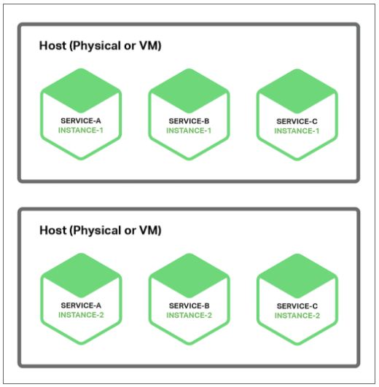
Multiple Service Instances per Host Pattern
One way to deploy your microservices is to use the Multiple Service Instances per Host pattern. When using this pattern, you provision one or more physical or virtual hosts and run multiple service instances on each one. In many ways, this the traditional approach to application deployment. Each service instance runs at a well-known port on one or more hosts. The host machines are commonly treated like pets.

Slide 9
Let’s discuss the Multiple Service Instances per Host pattern has both benefits and drawbacks.
Pros:
One major benefit is its resource usage is relatively efficient because multiple service instances share the server and its operating system.
It is even more efficient if a process or process group runs multiple service instances, for example, multiple web applications sharing the same Apache Tomcat server and JVM.
Another major benefit of this pattern is that deploying a service instance is relatively fast. You simply copy the service to a host and start it.
Cons:
Lack of overhead, starting a service is usually very fast. If the service is its own process, you simply start it. Otherwise, if the service is one of several instances running in the same container process or process group, you either dynamically deploy it into the container or restart the container.
Another major drawback is that there is little or no isolation of the service instances, unless each service instance is a separate process. There is no isolation at all if multiple service instances run in the same process.
Another significant problem with this approach is that the operations team that deploys a service has to know the specific details of how to do it.

Slide 10
Service Instance per Host Pattern
Another way to deploy your microservices is the Service Instance per Host pattern. When you use this pattern, you run each service instance in isolation on its own host.
There are two different specializations in this pattern:
Service Instance per Virtual Machine and
Service Instance per Container.
Service Instance per Virtual Machine
When you use Service Instance per Virtual Machine pattern, you package each service as a virtual machine (VM) image such as an Amazon EC2 AMI. Each service instance is a VM (for example, an EC2 instance) that is launched using that VM image
This is the primary approach used by Netflix to deploy its video streaming service. Netflix packages each of its services as an EC2 AMI using Aminator. Each running service instance is an EC2 instance.

Slide 11
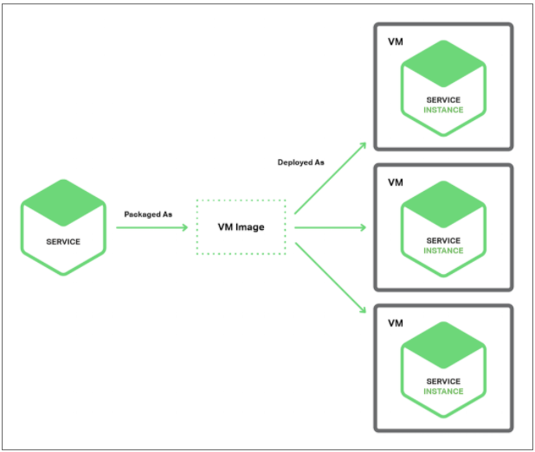

Slide 12
The Service Instance per Virtual Machine pattern has a number of benefits:
A major benefit of VMs is that each service instance runs in complete isolation. It has a fixed amount of CPU and memory and can’t steal resources from other services.
Another benefit of deploying your microservices as VMs is that you can leverage mature cloud infrastructure
Another great benefit of deploying your service as a VM is that it encapsulates your service’s implementation technology
The Service Instance per Virtual Machine pattern has some drawbacks:
Less efficient resource utilization
Major drawback is public IaaS typically charges for VMs regardless of whether they are busy or idle. Example: an IaaS such as AWS provides autoscaling but it is difficult to react quickly to changes in demand. Consequently, you often have to overprovision VMs, which increases the cost of deployment.
Other downside of this approach is that deploying a new version of a service is usually slow.
Another drawback of the Service Instance per Virtual Machine pattern is that usually you (or someone else in your organization) is responsible for a lot of undifferentiated heavy lifting.

Slide 13
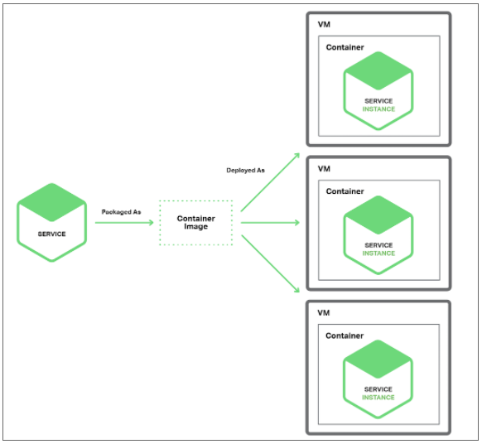
Service Instance per Container Pattern
When you use the Service Instance per Container pattern, each service instance runs in its own container. Containers are a virtualization mechanism at the operating system level. A container consists of one or more processes running in a sandbox. Examples of container technologies include Docker and Solaris Zones.

Slide 14
To use this pattern, you package your service as a container image.
A container image is a filesystem image consisting of the applications and libraries required to run the service. Some container images consist of a complete Linux root filesystem. Others are more lightweight like deploying a Java service
Once you have packaged your service as a container image, you then launch one or more containers. You usually run multiple containers on each physical or virtual host. You might use a cluster manager such as Kubernetes or Marathon or OpenShift to manage your containers. A cluster manager treats the hosts as a pool of resources. It decides where to place each container based on the resources required by the container and resources available on each host.
Benefits of the Service Instance per Container pattern:
The benefits of containers are similar to those of VMs. They isolate your service instances from each other. You can easily monitor the resources consumed by each container. Also, like VMs, containers encapsulate the technology used to implement your services.
Unlike VMs, containers are a lightweight technology. Container images are typically very fast to build.

Slide 15
Drawbacks of the Service Instance per Container pattern:
Container infrastructure is rapidly maturing, it is not as mature as the infrastructure for VMs. Also, containers are not as secure as VMs since the containers share the kernel of the host OS with one another.
The undifferentiated heavy lifting of administering the container images.
Containers are often deployed on an infrastructure that has per‑VM pricing. Consequently, as described earlier, you will likely incur the extra cost of overprovisioning VMs in order to handle spikes in load.
Serverless Deployment
It’s a newer and increasingly popular concept of server‑less deployment, which is an approach that sidesteps the issue of having to choose between deploying services in containers or VMs.
AWS Lambda is an example of serverless deployment technology. It supports Java, Node.js, and Python services. To deploy a microservice, you package it as a ZIP file and upload it to AWS Lambda.
A Lambda function is a stateless service. It typically handles requests by invoking AWS services.
A Lambda function can also invoke third‑party web services.

Slide 16
There are four ways to invoke a Lambda function:
Directly, using a web service request
Automatically, in response to an event generated by an AWS service such as S3, DynamoDB, Kinesis, or Simple Email Service
Automatically, via an AWS API Gateway to handle HTTP requests from clients of the application
Periodically, according to a cron‑like schedule
As you can see, AWS Lambda is a convenient way to deploy microservices. The request‑based pricing means that you only pay for the work that your services actually perform. Also, because you are not responsible for the IT infrastructure you can focus on developing your application.
There are, however, some significant limitations. It is not intended to be used to deploy long‑running services, such as a service that consumes messages from a third‑party message broker. Requests must complete within 300 seconds. Services must be stateless, since in theory AWS Lambda might run a separate instance for each request. They must be written in one of the supported languages. Services must also start quickly; otherwise, they might be timed out and terminated.

Slide 17
Inter Service Communication
In monolithic architectural style, the application will be tightly coupled and all the service endpoints can access the database through the database access layer, so there won’t be a need of inter-service communication. But when it comes to Microservices architecture, the application will be divided into different services and each service may have its own database in most of the cases as a best practice.
So, there will be a business need to interact one service with another service because one microservice should not directly access the other Microservices database as per the Microservice’s recommendation. So inter-service communication will play a major role in implementing Microservices.
Inter-service communication is basically two Microservices communicating using either HTTP protocol or asynchronous message patterns.
There are two types of inter-service communication in Microservices:
Synchronous communication
Asynchronous communication

Slide 18
Synchronous Communication
In synchronous communication, one service will communicate with another service through the rest endpoint using HTTP or https protocol. In this approach, calling service will wait until the caller service responds.
2. Asynchronous Communication
In asynchronous communication, one service will communicate with another service through the asynchronous messaging. The calling service will not wait to respond by the caller service. First, it will return a response to the user, then the remaining services will process the request.
Asynchronous I/O is different from asynchronous communication. Asynchronous I/O means request will not block the thread to complete the process. But coming to asynchronous communication in Microservices, one service will not wait for another service response.
Asynchronous communication in Microservices will be achieved through the messaging brokers like Apache Kafka, Apache ActiveMQ, etc.

Slide 19
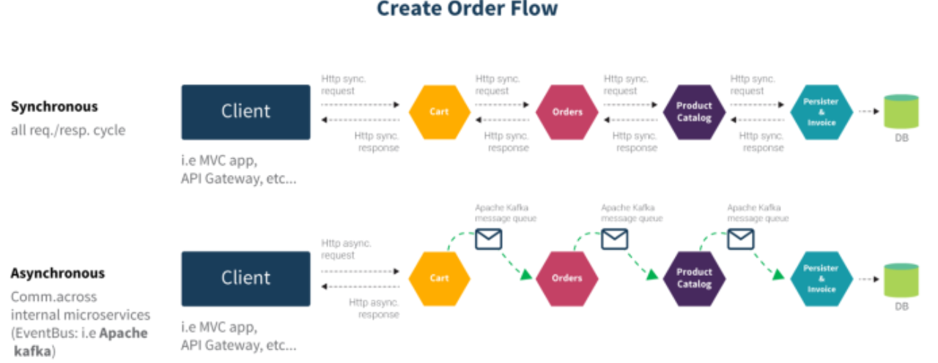
The following diagram illustrates, create order flow with
synchronous and asynchronous communication:

Slide 20
Pros and Cons of Synchronous Communication
Advantages:
Design complexity is low
Error handling is easy in synchronous communication
A real-time response on the go in synchronous communication.
Disadvantages:
Service should be available all the time and if service is not available then thread will be blocked and it will cause the performance issue.
Responsiveness is slow because the one service has to wait for the response of another service.
Need a connection-oriented protocol
Where & When:
In our application, if one service needs the real-time data from another service then you can use synchronous communication.
For example, if we take any e-commerce application when a customer searches for a particular product to purchase then that product’s availability needs to be validated in the inventory by making a request to product availability service. Because customer should know about the current availability of the product to place the order. In this case, you can use synchronous communication to get the product’s real-time availability in inventory and price information.

Slide 21
Pros and Cons of Asynchronous Communication
Advantages:
No need for the connection-oriented protocol. It will transfer messages using message brokers.
The response will be given immediately, so performance wise asynchronous communication is better than synchronous communication.
The sender doesn’t need to know about the consumer. So coupling between services is less.
No need for consumer service’s availability when the sender service sends a request
Failure isolation is better in asynchronous communication. Because if message broker fails to send the message, once the message broker gets recovered it will resend the message again.
Disadvantages:
Design complexity is high in asynchronous communication.
Error handling is complex
Coupling with message broker is high, so if you want to change the message broker infrastructure, it becomes difficult to manage in existing infrastructure.
Latency is very high if message queue fills up.
Cost of monitoring messaging infrastructure will be significant.

Slide 22
Where & When:
In our application, if the request needs to be processed through multiple services and needs approval or further processing, you can go ahead with asynchronous communication.
For example, In the banking domain, loan request should be processed and needs approval at multiple levels. So in this case, when a user raises a request for the loan then the loan request service will provide some reference number immediately. Once all the approvals are done, will persist the loan request details in the database. So in this scenario, we can use asynchronous communication.
Summary
In Microservices architecture style, communication between services will play an important role when it comes to performance. So based on your requirement, you have to choose the right approach for inter-service communication.

Slide 23
Microservices Internationalization
Internationalization
Internationalization is the design and development of a product, application or document content that enables easy localization for target audiences that vary in culture, region, or language.
Internationalization is often written in English as i18n, where 18 is the number of letters between i and n in the English word.
The value of internationalization
Internationalization significantly affects the ease of the product's localization. Retrofitting a linguistically- and culturally- centered deliverable for a global market is obviously much more difficult and time-consuming than designing a deliverable with the intent of presenting it globally.

Slide 24
Features of internationalization:
Designing and developing in a way that removes barriers to localization or international deployment. This includes such things as enabling the use of Unicode, or ensuring the proper handling of legacy character encodings where appropriate, taking care over the concatenation of strings, avoiding dependence in code of user-interface string values, etc.
Providing support for features that may not be used until localization occurs. For example, adding mark-up in your DTD to support bidirectional text, or for identifying language. Or adding to CSS support for vertical text or other non-Latin typographic features.
Enabling code to support local, regional, language, or culturally related preferences. Typically, this involves incorporating predefined localization data and features derived from existing libraries or user preferences. Examples include date and time formats, local calendars, number formats and numeral systems, sorting and presentation of lists, handling of personal names and forms of address, etc.
Separating localizable elements from source code or content, such that localized alternatives can be loaded or selected based on the user's international preferences as needed.

Slide 25


Slide 26
How to Implement I18N in Microservices
1. LocaleResolver
In order for our application to be able to determine which locale is currently being used, we need to add a LocaleResolver bean:
@Bean
public LocaleResolver localeResolver() {
return new AcceptHeaderLocaleResolver();
}
2. Locale ChangeInterceptor
The LocaleResolver interface has implementations that determine the current locale based on the session, cookies, the Accept-Language header, or a fixed value. In above example we have set Locale as US i.e. English
Next, we need to add an interceptor bean that will switch to a new locale based on the value of the "language" parameter appended to a request:
@Bean
public LocaleChangeInterceptor localeChangeInterceptor() {
return new LocaleChangeInterceptor();
}

Slide 27
3. Register this interceptor as follows
@Override
public void addInterceptors(InterceptorRegistry registry) {
registry.addInterceptor(localeChangeInterceptor());
}
4. Properties Files - We need to have now locale specific properties files e.g.
a. Messages.properties... English messages
autres=Others Mademoiselle=Miss Majeure=Major Monsieur.=Mr.
b. Messages_fr.properties ... French messages
Mr.=Monsieur. Miss=Mademoiselle Major=Majeure Others=autres
messageSource.getMessage(description, null, description, LocaleContextHolder.getLocale());

Slide 28
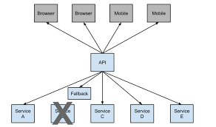
Hystrix Circuit Breaker
When calls to a particular service exceed circuitBreaker.requestVolumeThreshold (default: 20 requests)
And the failure percentage is greater than circuitBreaker.errorThresholdPercentage (default: >50%)
In a rolling window defined by circuitBreaker.sleepWindowInMilliseconds (default: 10 seconds),
The circuit opens and the call is not made. In cases of error and an open circuit, a fallback can be provided by the developer.

Slide 29
Transaction Management – Saga pattern
Business transaction that spans multiple services is a saga.
A saga is a sequence of local transactions.
Each local transaction updates the database and publishes a message or event to trigger the next local transaction in the saga.
If a local transaction fails because it violates a business rule then the saga executes a series of compensating transactions that undo the changes that were made by the preceding local transactions.

Slide 30
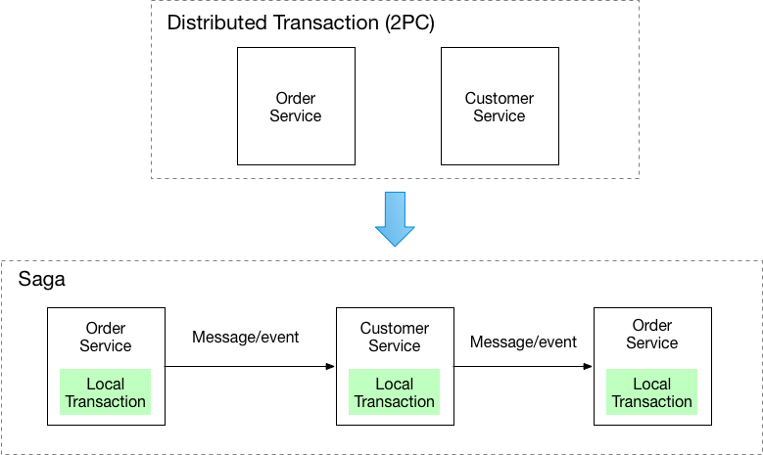
Transaction Management – Saga pattern

Slide 31
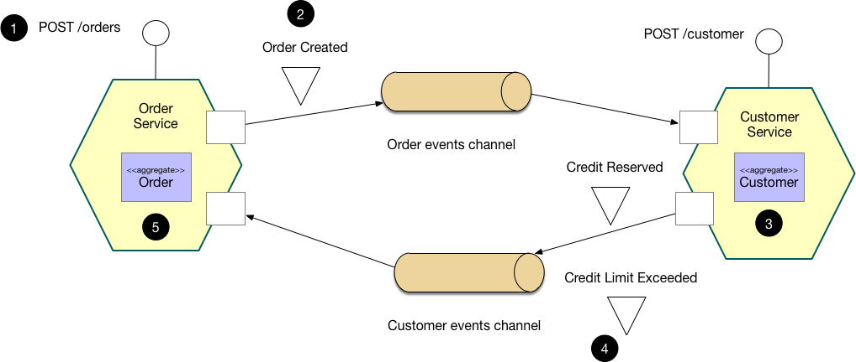
Choreography based - Saga

Slide 32
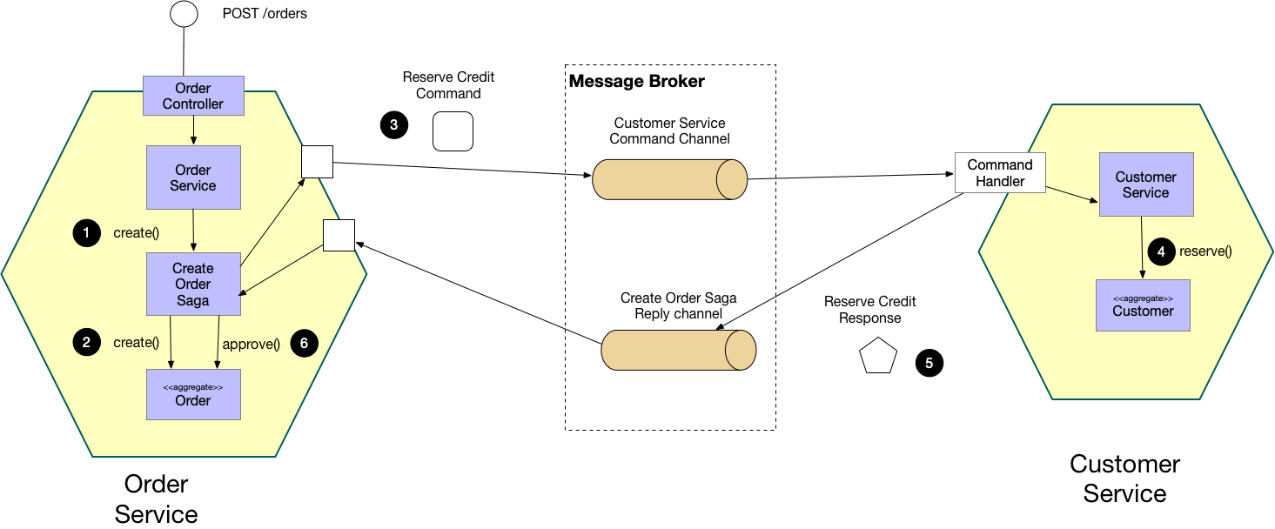
Orchestration based - Saga

